Slide 1


FPT SOFTWARE
Machine Learning Fundamentals
10/02/18

Slide 2
Machine Learning Fundamentals
Lecture 3: Unsupervised Learning
Outline:
The Different Between Supervised Learning and Unsupervised Learning
Clustering and Dimensionality Reduction
Recommender Systems
Project

Slide 3
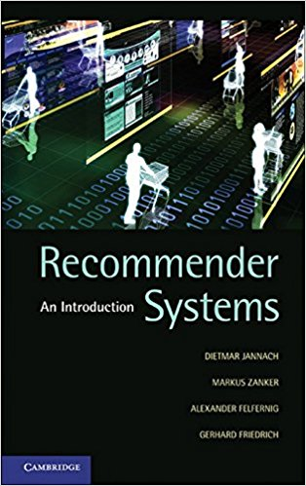
Recommender Systems
If you are interested in Recommender System and the mathematics behind, you could read more in this recommended book:
Recommender Systems by Jannack and Zanker

Slide 4
Recommender Systems
The two most common types of recommender systems are Content-Based and Collaborative Filtering (CF)
Content-Based recommender systems focus on the attributes of the items and give you recommendations based on the similarity between them
Collaborative Filtering produces recommendations based on the knowledge of the user’s attitude to items, that is it uses the ‘wisdom of the crowd’ to recommend items.
Generally, Collaborative Filtering (CF) is more commonly used than content-based systems because it usually gives better results and is relatively easy to understand (from implementation perspective)
The algorithm has the ability to do feature learning on its own, which means that it can learn for itself what features to use.

Slide 5
Recommender Systems
The two most common types of recommender systems are Content-Based and Collaborative Filtering (CF)
…
CF can be divided into Memory-Based Collaborative Filtering and Model-Based Collaborative Filtering
Another type of Recommender Systems is based on Hybrid method which combines different main methods.

Slide 6
Recommender Systems
Exercise

